Slide 1
Lecture 3
Ethernet Fundamentals
Software Development
Systems Software & Networks
Patrick Donohue

Slide 2

Introduction to Ethernet
Most of the traffic on the Internet originates and ends with Ethernet connections.
Ethernet has evolved to meet the increased demand for high-speed LANs.
When optical fibre media was introduced, Ethernet adapted to take advantage of the superior bandwidth and low error rate that fiber offers.
Now the same protocol that transported data at 3 Mbps in 1973 can carry data at 10 Gbps.

Slide 3
The success of Ethernet is due to the following factors:
Simplicity and ease of maintenance
Ability to incorporate new technologies
Reliability
Low cost of installation and upgrade

Slide 4
Scalability
All the standards are essentially compatible with the original Ethernet standard.
An Ethernet frame could leave an older coax 10-Mbps NIC in a PC, be placed onto a 10-Gbps Ethernet fibre link, and end up at a 100-Mbps NIC.
As long as the frame stays on Ethernet networks it is not changed.
For this reason Ethernet is considered very scalable.
The bandwidth of the network could be increased many times while the Ethernet technology remains the same.
The original Ethernet standard has been amended many times to manage new media and higher transmission rates.
  These amendments provide standards for new technologies and maintain compatibility between Ethernet variations.

Slide 5
IEEE Ethernet naming rules
Ethernet is not one networking technology, but a family of networking technologies that includes Legacy, Fast Ethernet, and Gigabit Ethernet.
Ethernet speeds can be 10, 100, 1000, or 10,000 Mbps.
The basic frame format and the IEEE sublayers of OSI Layers 1 and 2 remain consistent across all forms of Ethernet.

Slide 6
When Ethernet needs to be expanded to add a new medium or capability, the IEEE issues a new supplement to the 802.3 standard.
The new supplements are given a one or two letter designation such as 802.3u.
An abbreviated description, called an identifier, is also assigned to the supplement.

Slide 7
The abbreviated description consists of the following elements:
A number that indicates the number of Mbps transmitted
The word base to indicate that baseband signalling is used
One or more letters of the alphabet indicating the type of medium used.
For example, F = fibre optical cable and T = copper unshielded twisted pair

Slide 8
IEEE cannot force manufacturers to fully comply with any standard.
IEEE has two main objectives:
  Supply the information necessary to build devices that comply with Ethernet standards
  Promote innovation among manufacturers

Slide 9
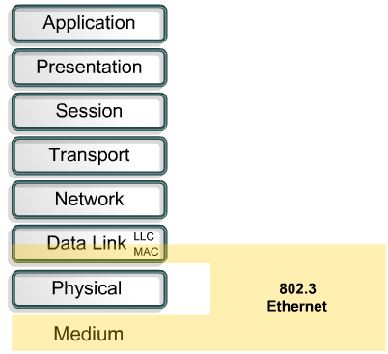
Ethernet and the OSI model
Ethernet operates in two areas of the OSI model. These are the lower half of the data link layer, which is known as the MAC sublayer, and the physical layer.

Slide 10
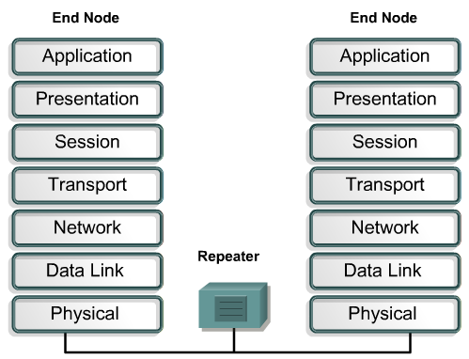
A repeater as seen by the OSI model
Data that moves from one Ethernet station to another often passes through a repeater.
All stations in the same collision domain see traffic that passes through a repeater.
A collision domain is a shared resource.
Problems that originate in one part of a collision domain will usually impact the entire collision domain.

Slide 11
A repeater forwards traffic to all other ports.
A repeater never sends traffic out the same port from which it was received.
Any signal detected by a repeater will be forwarded.
If the signal is degraded through attenuation or noise, the repeater will attempt to reconstruct and regenerate the signal.

Slide 12
To guarantee minimum bandwidth and operability,
standards specify the maximum number of stations per segment,
maximum segment length,
maximum number of repeaters between stations.
Stations separated by bridges or routers are in different collision domains.

Slide 13
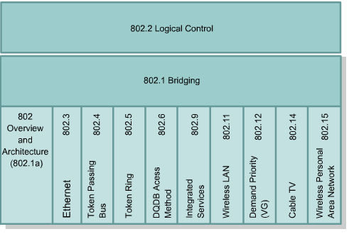
Ethernet 802.x standards
Ethernet technologies mapped to the lower half of OSI Layer 2 and all of Layer 1.
Ethernet at Layer 1 involves signals, bit streams that travel on the media, components that put signals on media, and various topologies.
Ethernet Layer 1 performs a key role in the communication that takes place between devices, but each of its functions has limitations which are addressed by Layer 2 (next slide)

Slide 14
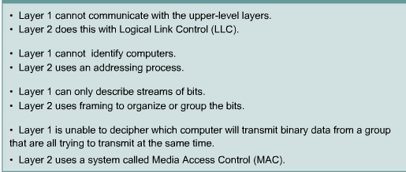
Layer 2 addresses Layer 1 limitations

Slide 15
Data link sublayers contribute significantly to technological compatibility and computer communications.
The MAC sublayer is concerned with the physical components that will be used to communicate the information.
The Logical Link Control (LLC) sublayer remains relatively independent of the physical equipment that will be used for the communication process.

Slide 16
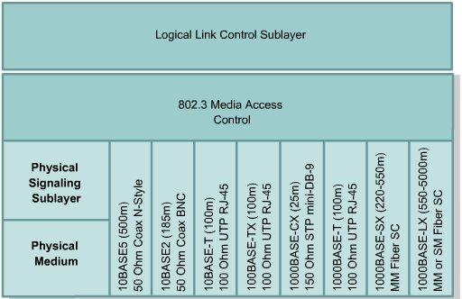
The figure maps a variety of Ethernet technologies to the lower half of OSI Layer 2 and all of Layer 1.
While there are other varieties of Ethernet, the ones shown are the most widely used.

Slide 17
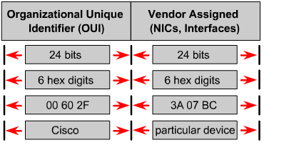
Naming
An address system is required to uniquely identify computers and interfaces to allow for local delivery of frames on the Ethernet.
Ethernet uses MAC addresses that are 48 bits in length and expressed as 12 hexadecimal digits. T
First six hexadecimal digits, which are administered by the IEEE, identify the manufacturer or vendor.
This portion of the MAC address is known as the Organizational Unique Identifier (OUI).
The remaining six hexadecimal digits represent the interface serial number or another value administered by the manufacturer.
MAC addresses are sometimes referred to as burned-in MAC addresses (BIAs) because they are burned into ROM and are copied into RAM when the NIC initializes.

Slide 18
At the data link layer MAC headers and trailers are added to upper layer data.
The header and trailer contain control information intended for the data link layer in the destination system.
The data from upper layers is encapsulated within the data link frame, between the header and trailer, and then sent out on the network.

Slide 19
The NIC uses the MAC address to determine if a message should be passed on to the upper layers of the OSI model.
The NIC does not use CPU processing time to make this assessment.
This enables better communication times on an Ethernet network.

Slide 20
When a device sends data on an Ethernet network, it can use the destination MAC address to open a communication pathway to the other device.
The source device attaches a header with the MAC address of the intended destination and sends data through the network.
As this data travels along the network media the NIC in each device checks to see if the MAC address matches the physical destination address carried by the data frame.
If there is no match, the NIC discards the data frame.
When the data reaches the destination node, the NIC makes a copy and passes the frame up the OSI layers.
On an Ethernet network, all nodes must examine the MAC header.

Slide 21
All devices that are connected to the Ethernet LAN have MAC addressed interfaces.
This includes workstations, printers, routers, and switches.

Slide 22
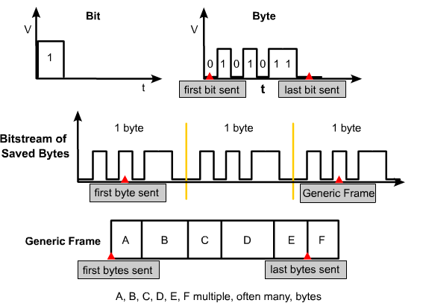
Layer 2 framing
Encoded bit streams, or data, on physical media represent a tremendous technological accomplishment, but they, alone, are not enough to make communication happen.
Framing provides essential information that could not be obtained from coded bit streams alone.

Slide 23
Framing information includes:
Which computers are in communication with each other
When communication between individual computers begins and when it ends
Which errors occurred while the computers communicated
Which computer will communicate next

Slide 24
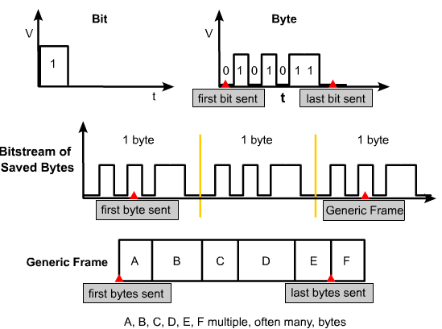
A voltage versus time graph could be used to visualize bits.
It may be too difficult to graph address and control information for larger units of data.
Another type of diagram that could be used is the frame format diagram, which is based on voltage versus time graphs.
Frame format diagrams are read from left to right, just like an oscilloscope graph.
The frame format diagram shows different groupings of bits, or fields, that perform other functions.

Slide 25
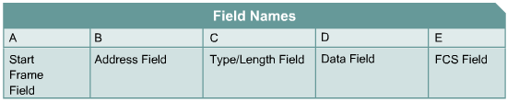
Generic Frame format
Framing is the Layer 2 encapsulation process.
A frame is the Layer 2 protocol data unit.
There are many different types of frames described by various standards.
A single generic frame has sections called fields. Each field is composed of bytes.
The names of the fields are as follows:
Start Frame field
Address field
Length/Type field
Data field
Frame Check Sequence (FCS) field

Slide 26
When computers are connected to a physical medium, there must be a way to inform other computers when they are about to transmit a frame.
Various technologies do this in different ways.
Regardless of the technology, all frames begin with a sequence of bytes to signal the data transmission.

Slide 27
All frames contain naming information, such as the name of the source node, or source MAC address, and the name of the destination node, or destination MAC address.
Most frames have some specialized fields. In some technologies, a Length field specifies the exact length of a frame in bytes.
Some frames have a Type field, which specifies the Layer 3 protocol used by the device that wants to send data.

Slide 28
Frames are used to send upper-layer data and ultimately the user application data from a source to a destination.
The data package includes the message to be sent, or user application data.
Extra bytes may be added so frames have a minimum length for timing purposes.
LLC bytes are also included with the Data field in the IEEE standard frames.
The LLC sublayer takes the network protocol data, which is an IP packet, and adds control information to help deliver the packet to the destination node.
Layer 2 communicates with the upper layers through LLC.

Slide 29
FCS Field
All frames and the bits, bytes, and fields contained within them, are susceptible to errors from a variety of sources.
The FCS field contains a number that is calculated by the source node based on the data in the frame.
This number is added to the end of a frame that is sent.
When the destination node receives the frame the FCS number is recalculated and compared with the FCS number included in the frame.
If the two numbers are different, an error is assumed, the frame is discarded.

Slide 30
ACK
Because the source cannot detect that the frame has been discarded, retransmission has to be initiated by higher layer connection-oriented protocols providing data flow control.
Because these protocols, such as TCP, expect frame acknowledgment, ACK, to be sent by the peer station within a certain time, retransmission usually occurs.

Slide 31
There are three primary ways to calculate the FCS number:
Cyclic redundancy check (CRC) – performs calculations on the data.
Two-dimensional parity – places individual bytes in a two-dimensional array and performs redundancy checks vertically and horizontally on the array, creating an extra byte resulting in an even or odd number of binary 1s.
Internet checksum – adds the values of all of the data bits to arrive at a sum.

Slide 32
The node that transmits data must get the attention of other devices to start and end a frame.
The Length field indicates where the frame ends.
The frame ends after the FCS.
Sometimes there is a formal byte sequence referred to as an end-frame delimiter.

Slide 33
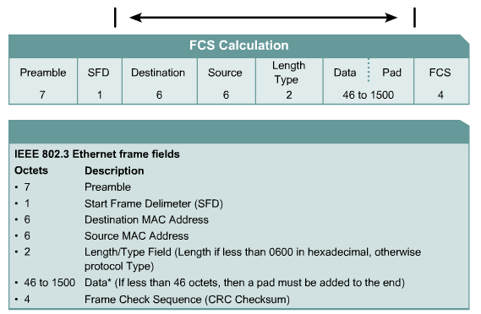
Ethernet frame structure
IEEE 802.3 Ethernet frame structure
At the data link layer the frame structure is nearly identical for all speeds of Ethernet from 10 Mbps to 10,000 Mbps.
However, at the physical layer almost all versions of Ethernet are very different.
Each speed has a distinct set of architecture design rules.

Slide 34
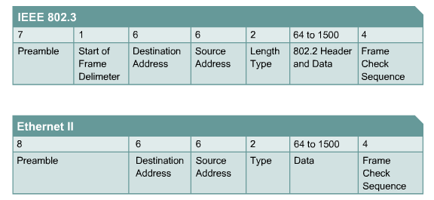
Ethernet frame fields
Some of the fields permitted or required in an 802.3 Ethernet frame are as follows:
Preamble
SOF Delimiter
Destination Address
Source Address
Length/Type
Header and Data
FCS
Extension

Slide 35
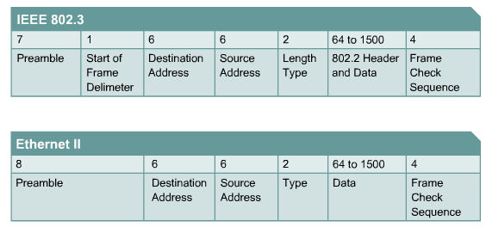
The Source Address field contains the MAC source address.
The source address is generally the unicast address of the Ethernet node that transmitted the frame.
However, many virtual protocols use and sometimes share a specific source MAC address to identify the virtual entity.

Slide 36
The Length/Type field supports two different uses.
If the value is less than 1536 decimal, 0x600 hexadecimal, then the value indicates length.
The length interpretation is used when the LLC layer provides the protocol identification.
The type value indicates which upper-layer protocol will receive the data after the Ethernet process is complete.
The length indicates the number of bytes of data that follows this field.

Slide 37
The Data field and padding if necessary, may be of any length that does not cause the frame to exceed the maximum frame size.
The maximum transmission unit (MTU) for Ethernet is 1500 octets, so the data should not exceed that size.
The content of this field is unspecified.
An unspecified amount of data is inserted immediately after the user data when there is not enough user data for the frame to meet the minimum frame length.
This extra data is called a pad. Ethernet requires each frame to be between 64 and 1518 octets.

